Slide 1
MODERN APPROACHES IN POLITICAL SCIENCE
SUMITA SINHA
To overcome the paucities of the traditional approaches, various new approaches have been promoted by the new political intellectuals. These new approaches are considered as the "modern approaches" to the study of political science.

Slide 2
CHARACTERISTICS OF MODERN APPROACHES
These approaches draw conclusion from empirical data.
These approaches go beyond the study of political structures and its historical analysis.
Modern Approaches believe in inter-disciplinary study.
They stress scientific methods of study and attempt to draw scientific conclusions in Political Science.

Slide 3
POLITICAL ECONOMIC APPROACH
Economics and politics are vital arenas of social science and in several respects, they are closely related. In the prospectus of universities of India and many other countries a few decades ago, economics and political science established a single subject which suggests the close relationship between the two. This signifies that in the study of politics, economics has great importance.

Slide 4
SYSTEM APPROACH
The notion of Systems Theory was emerged from ancient time, dates back to 1920s, Ludwig Von Bertallanfy is considered as the earliest advocate of the general systems theory.
This approach describes the relationship of political life with other aspects of social life. The idea of a system was initially borrowed from biology by Talcott Parsons who first promoted the concept of sucial system.
After Talcott Parsons, David Easton further developed the concept of a political system.

Slide 5
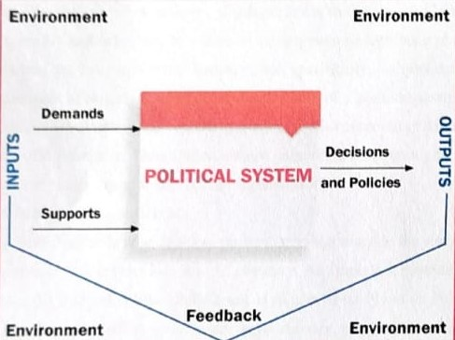
Input-Output model of Devid Easton

Slide 6
BEHAVIOURAL APPROACH
Behaviouralism is considered as contemporary approach to the study of political science. But this approach was emerged during 20th century.
Behaviouralism stresses upon scientific, objective and value-free study of the political occurrences as conditioned by the environment, firmly the behaviour of the individuals involved in that phenomena.

Slide 7
STRIKING FEATURES OF BEHAVIOURALINM
Regularities
Verification
Techniques
Quantification
Values
Systematization
Pure Science
Integration

Slide 8
ADVANTAGES OF BEHAVIOURAL APPROACH
This approach attempts to make Political Science as a scientific method
Behaviouralism has bought human behaviour into the arena of Political Science
This approach helps in predicting future political events

Slide 9
CRITICISM
This approach has been mainly criticized for its dependence on techniques and methods and ignoring the subject matter.

Slide 10
STRUCTURAL FUNCTIONAL APPROACH
Gabriel Almond was an advocate of this approach. He described political systems as a special system of interaction that exists in all societies performing certain functions.
Like Easton, Almond also believes that all political systems perform input and output functions.

Slide 11
INPUT FUNCTIONS OF POLITICAL SYSTEMS
Political Socialization and Recruitment.
Interest-Articulation.
Interest-Aggression.
Political Communication.

Slide 12
OUTPUT FUNCTIONS OF POLITICAL SYSTEMS
Rule making.
Rule application.
Rule adjudication.

Slide 13
Thank You
Thank You

