Slide 2
Digital Electronics 3
Dr. Apurba Kanti Deb
Associate Professor
AND, OR and NOT Gates (realization using Diodes and Transistor). NAND and NOR Gates as Universal Gates.

Slide 3
OR gate
Two or more inputs, only one output. If any one or more inputs are in
‘ON’(1) state output is ‘ON’(1). If all the inputs are ‘OFF’(0) state only then output if ‘OFF’(0)
Boolean expression Y= A+B+C+..
Truth table: for two inputs
A | B | Y=A+B
0 | 0 | 0
0 | 1 | 1
1 | 0 | 1
1 | 1 | 1

Slide 4
OR gate
A | B | C | Y
0 | 0 | 0 | 0
0 | 0 | 1 | 1
0 | 1 | 0 | 1
0 | 1 | 1 | 1
1 | 0 | 0 | 1
1 | 0 | 1 | 1
1 | 1 | 0 | 1
1 | 1 | 1 | 1
Truth table: for three inputs
Circuit Symbol

Slide 5
OR gate
Circuit realizing OR gate using diodes and Transistors

Slide 6
AND gate
Two or more inputs, only one output. If any one or more inputs are in
‘OFF’(0) state output is ‘OFF’(0). If all the inputs are ‘ON’(1) state only then output if ‘ON’(1)
Boolean expression Y= A.B.C..
Truth table: for two inputs
A | B | Y=A.B
0 | 0 | 0
0 | 1 | 0
1 | 0 | 0
1 | 1 | 1

Slide 7
AND gate
A | B | C | Y
0 | 0 | 0 | 0
0 | 0 | 1 | 0
0 | 1 | 0 | 0
0 | 1 | 1 | 0
1 | 0 | 0 | 0
1 | 0 | 1 | 0
1 | 1 | 0 | 0
1 | 1 | 1 | 1
Truth table: for three inputs
Circuit Symbol

Slide 8
AND gate
Circuit realizing AND gate using diodes and transistors

Slide 9
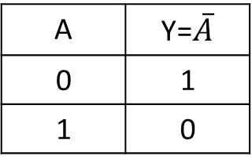
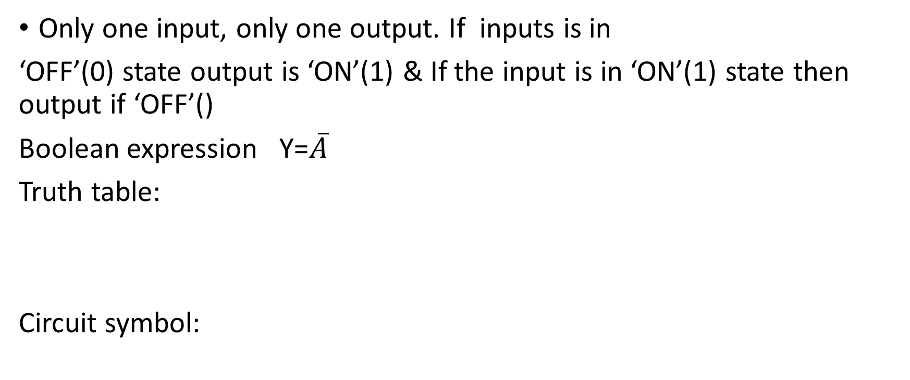
NOT gate
Only one input, only one output. If inputs is in
‘OFF’(0) state output is ‘ON’(1) & If the input is in ‘ON’(1) state then output if ‘OFF’()
Boolean expression Y=$\overline{A}$
Truth table:
Circuit symbol:
A | Y=$\overline{A}$
0 | 1
1 | 0

Slide 10
NOT gate
Circuit using Transistors

Slide 11
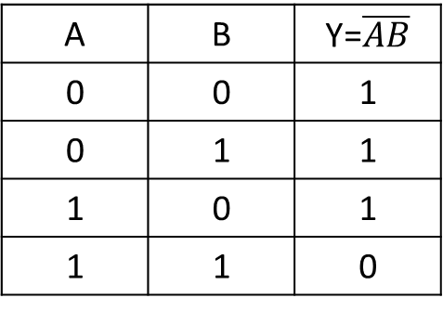
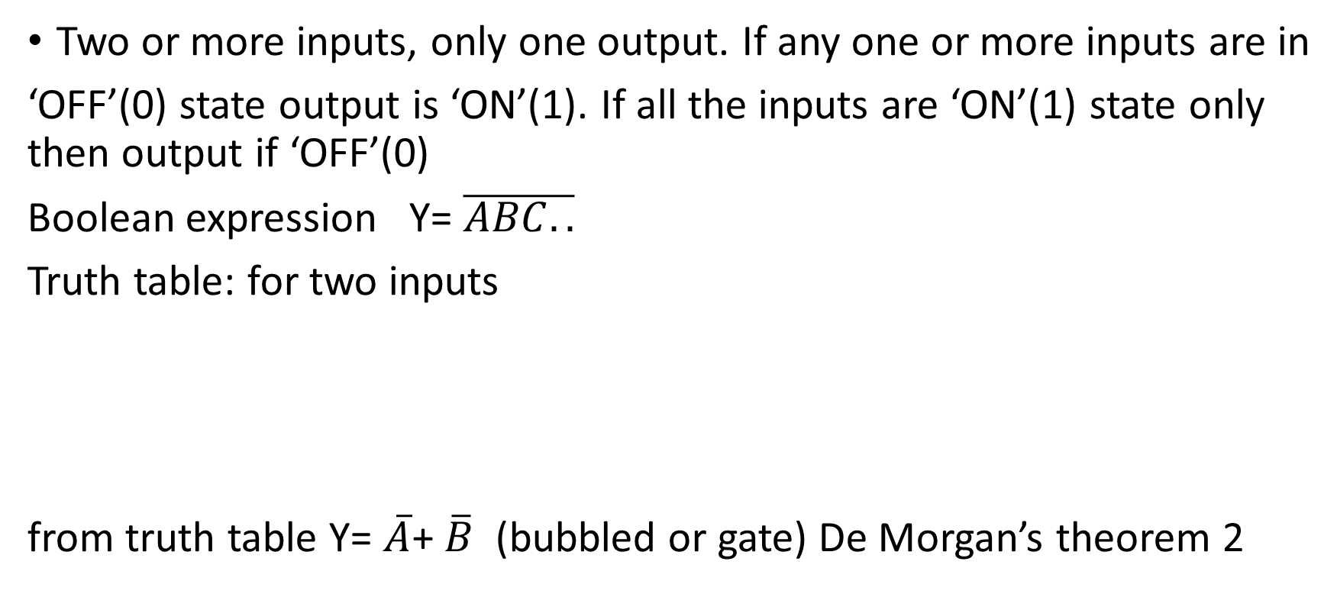
NAND gate
Two or more inputs, only one output. If any one or more inputs are in
‘OFF’(0) state output is ‘ON’(1). If all the inputs are ‘ON’(1) state only then output if ‘OFF’(0)
Boolean expression Y= $\overline{ABC..}$
Truth table: for two inputs
from truth table Y= $\overline{A}$+ $\overline{B}$ (bubbled or gate) De Morgan’s theorem 2
A | B | Y=$\overline{AB}$
0 | 0 | 1
0 | 1 | 1
1 | 0 | 1
1 | 1 | 0

