Slide 1
Agro-Climatic Regions of India
By
Dr. Nuruzzaman Kasemi
Associate Professor
Department of Geography
Raiganj University

Slide 2
Agricultural regionalisation
Differentiated segment of earth surface (Whittlesry, 1935)
Uninterrupted area in respect of agricultural land, practices and pattern.
Distinctive form of agriculture
Dynamic concept

Slide 3
Agricultural region Characteristics
Location
Transitional boundaries
Formal or functional
Hierarchically arranged
Delineation of agricultural region
Empirical technique
Single-element technique
Multi-element or statistical technique
Cropping pattern, concentration, diversification
Crop combination
Regional pattern of agricultural productivity
Quantative-cum-Qualitative

Slide 4
Agro-Climatic Regions of India
The Planning Commission and National Remote Sensing Agency (NRSA)
On the basis of geo-climatic, socio-economic and agricultural practices variations
In 1988 the Planning Commission came up with a growth strategy based on a holistic approach of area planning for long-term resource efficiency and sustainability.
15 Agro-climatic regions

Slide 5
Objectives of Agro-Climatic Regions
Agricultural production
Farm income
More rural employment
Available irrigation water
Regional inequalities and development of agriculture

Slide 6
Agro-Climatic Regions of India
Zone 1- Western Himalayan Region: Jammu and Kashmir, Uttar Pradesh
Zone 2 - Eastern Himalayan Region: Assam, Sikkim, West Bengal and all North-Eastern states
Zone 3 - Lower Gangetic Plains Region: West Bengal
Zone 4 - Middle Gangetic Plains Region: Uttar Pradesh, Bihar
Zone 5 - Upper Gangetic Plains Region: Uttar Pradesh Zone

Slide 7
Contd.
6 - Trans-Gangetic Plains Region: Punjab, Haryana, Delhi and Rajasthan
Zone 7 - Eastern Plateau and Hills Region: Maharashtra, Uttar Pradesh, Orissa and West Bengal
Zone 8 - Central Plateau and Hills Region: MP, Rajasthan, Uttar Pradesh
Zone 9 - Western Plateau and Hills Region: Maharashtra, Madhya Pradesh and Rajasthan
Zone 10 - Southern Plateau and Hills Region: Andhra Pradesh, Karnataka, Tamil Nadu

Slide 8
Contd.
Zone 11 - East Coast Plains and Hills Region: Orissa, Andhra Pradesh, Tamil Nadu and Pondicherry
Zone 12 - West Coast Plains and Ghat Region: Tamil Nadu, Kerala, Goa, Karnataka, Maharashtra
Zone 13 - Gujarat Plains and Hills Region: Gujarat
Zone 14 - Western Dry Region: Rajasthan
Zone 15 - The Islands Region: Andaman and Nicobar, Lakshadweep.

Slide 9
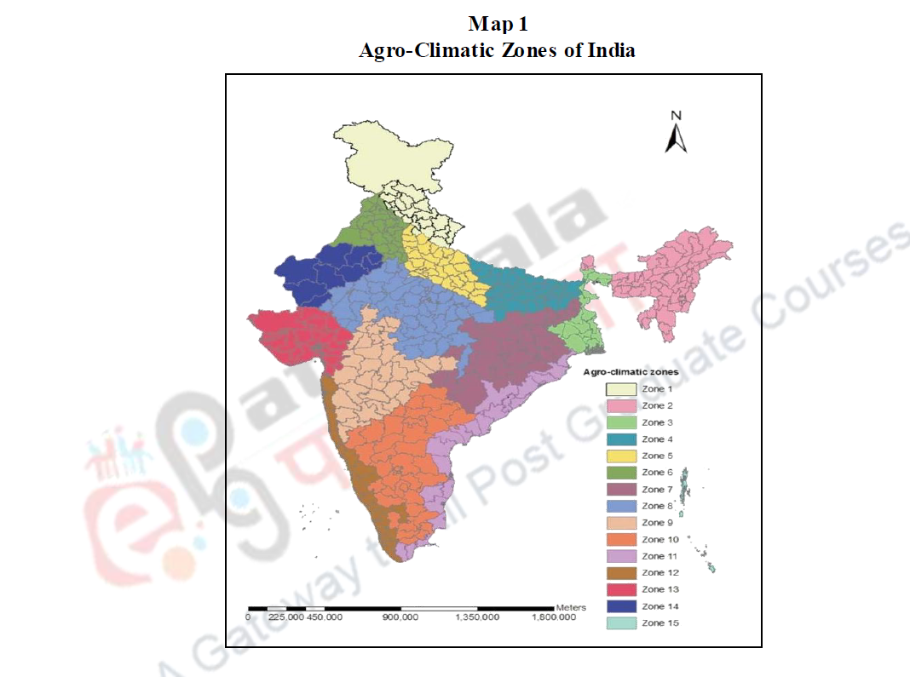

Slide 10
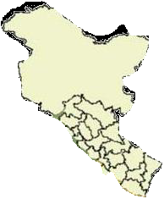
Zone 1- Western Himalayan Region
Great variation in relief.
July average temperature 5°C-30°C
January temperature 0°C to -4°C
Average annual rainfall is 150 cms
Valleys and duns have thick layers of alluvium while hill slopes have thin brown hilly soils.
Number of perennial streams due to high rainfall and snow- covered mountain peaks (Ganga, Yamuna, Jhelum, Chenab, Satluj and Beas etc.)

Slide 11
Contd.
Rice is the main crop of this region which is cultivated in terraced fields along the hill slopes. Maize, wheat, potato, barley are other important crops.
The horticulture of the region is obsessed with the problems of financial crisis, lack of improved varieties of plants and high post-harvest losses (about 20% in packing, storage, marketing and processing).
A more rational land use planning is required for the region.
Land suitable for agriculture, horticulture, pasture, forestry

Slide 12
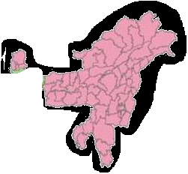
Zone 2 - Eastern Himalayan Region
The Eastern Himalayan region consists of Sikkim, Darjeeling area (West Bengal), Arunachal Pradesh, Assam hills, Nagaland, Meghalaya, Manipur, Mizoram and Tripura.
Rugged topography, forest cover and sub-humid climate (rainfall over 200 cm; temperature July 25°C-33°C, January 11°C-24°C).
The soil is brownish, thick layered and less fertile. Shifting cultivation (Jhum) is practised.

Slide 13
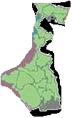
Zone 3 - Lower Gangetic Plains Region
This region spreads over eastern Bihar, West Bengal and Assam valley
100 cm-200 cm, July month varies from 26°C-41°C and for January month 9°C-240C
Adequate storage of groundwater
Rice is the main crop
Jute, maize, potato, and pulses are other important crops.

Slide 14
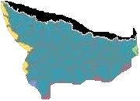
Zone 4 - Middle Gangetic Plains Region
Eastern Uttar Pradesh and Bihar (except Chotanagpur plateau).
26°C- 4I°C & 9°C-24°C, 100 cm and 200 cm
Rice, maize, millets in, kharif, wheat, gram, barley, peas, mustard and potato in rabi are important crops
Modern market oriented agriculture

Slide 15
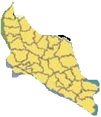
Zone 5 - Upper Gangetic Plains Region
Central and western parts of Uttar Pradesh
Sub-humid continental, 26°-41°C & 7°- 23°C , 75 cm- 150 cm, sandy loam.
Needs special focus on dairy development and horticulture
Rice-potato- wheat-moong and sugarcane , sunflower, and potato + mustard;
Improving irrigation system and water management

Slide 16
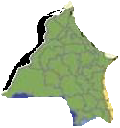
Zone 6 - Trans-Gangetic Plains Region
Punjab, Haryana, Delhi, Chandigarh and Ganganagar dis-trict of Rajasthan.
Semiarid, 26°C and 42°C & 7°C to 22°C, 70 cm and 125 cm.
Wheat, sugarcane, cotton, rice, gram, maize, millets, pulses and oilseeds etc.
Credit of introducing Green Revolution
Problem of water logging, salinity, alkalinity, soil erosion and falling water table

Slide 17
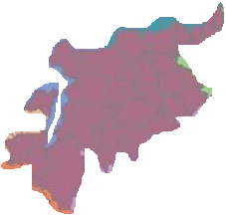
Zone 7 - Eastern Plateau and Hills Region
Chotanagpur plateau Rajmahal hills, Chhattisgarh plains and Dandakaranya
26°C-34°C & 10°C-27° C, 80 cm-150 cm, patches of laterites and alluviums
Deficient in water resources
Rice, millets, maize, oilseeds, ragi, gram and potato.

Slide 18
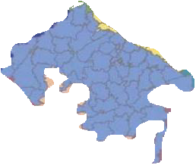
Zone 8 - Central Plateau and Hills Region
Bundelkhand, Baghelkhand, Bhander plateau, Malwa plateau and Vindhyachal hills
Sub-humid, 26°C-40°C & 7°C-24°C, 50 cm- 100 cm , mixed red, yellow and black growing
Millets, gram, barley, wheat, cotton, sunflower, etc.
Dearth of water resources

Slide 19
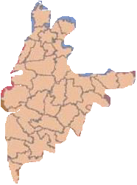
Zone 9 - Western Plateau and Hills Region
Southern part of Malwa plateau and Deccan plateau (Maharashtra).
24°C-41 °C & 6°C- 23°C, 25 cm-75 cm.
Jowar, cotton, sugarcane, rice, bajra, wheat, gram, pulses, potato, groundnut and oilseeds are the principal crops. The area is known for its oranges, grapes and bananas.

Slide 20
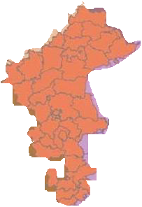
Zone 10 - Southern Plateau and Hills Region
Maharashtra, Karnataka, western Andhra Pradesh and northern Tamil Nadu.
Semi-arid with only 50 per cent of area cultivated, 26°C to 42°C & 13°C-21°C, 50 cm-100 cm.
Millets predominate. Coffee, tea, cardamom and spices

Slide 21
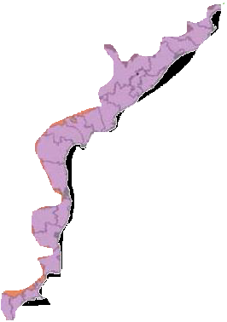
Zone 11 - East Coast Plains and Hills Region
Coromandel and Northern Circar coasts
Sub-humid maritime, 26°C-32°C & 20°C-29°C, 75 cm-150 cm, alluvial, loam and clay facing the menacing problem of alkalinity
Rice, jute, tobacco, sugarcane,
maize, millets, groundnut and oilseeds
Problems of water logging
and alkalinity.

Slide 22

Zone 12 - West Coast Plains and Ghats Region
Malabar and Konkan coasts and the Sahyadris and is covered by laterite and coastal alluvials.
200 cm, 26°C-32°C and 19°C-28°C
Rice, coconut, oilseeds, sugarcane, millets, pulses and cotton are the main crops
Famous for plantation crops and spices which are raised along the hill slopes of the Ghats.

Slide 23

Zone 13 - Gujarat Plains and Hills Region
Kathiawar and fertile valleys of Mahi and Sabarmati rivers
Arid an semi-arid region, 50 cm-100 cm, 26°C-42°C and 13°C-29°C, regur, red and yellow & alluvium soil
Groundnut, cotton, rice, millets, oilseeds, wheat and tobacco are the main crops
Canal and ground water management, rain water harvesting and management, dry land farming

Slide 24
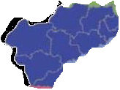
Zone 14 - Western Dry Region
Western Rajasthan west of the Aravallis
Hot sandy desert, 25 cm, high evaporation, 28°C- 45°C and 5°C-22°C, absence of perennial rivers, and scanty vegetation.
Bajra, jowar, and moth are main crops of kharif and wheat and gram in rabi.
Livestock contributes greatly in desert ecology

Slide 25


Zone 15 - The Islands Region
Andaman-Nicobar and Lakshadweep
300 cm, 30°C and 25°C, sandy loamy soil
Rice, maize, millets, pulses, areca nut, turmeric and cassava. Nearly half of the area is under coconut.

Slide 26
Conclusions
The ACRP approach presented the evolution of an innovative planning exercise encompassing several challenges such as geographical units of disaggregation.
ACRP can progress steadily beyond its present status of an experimental exercise provided it makes judicious use of the links with the implementing agencies and rapport with the state governments.

Slide 27
References
http://mowr.gov.in/agro-climatic-zones
http://epgp.inflibnet.ac.in/epgpdata/uploads/epgp_content/S000017GE/P001699/M020287/ET/1496119535Agro-climaticzones(2.pdf

