Slide 1
Vibrational Spectroscopy
Dr Abhik Chatterjee
Physical Chemistry.
Dept of Chemistry
Raiganj University

Slide 2
Why atomic spectra is not enough?
Just identifying the type of atoms in molecules is not enough to identify the compound:
We need a technique which can give information about the 1. Chemical bonds between the atoms 2. Structure So we are looking for a physical phenomenon which is sensitive to the molecular structure and chemical bond…

Slide 3
It's a method for identifying chemical compounds based on how infrared radiation interacts with chemical bonds.Absorption spectroscopy is the most usually applied technique.Provides details on the functional groups found in molecules.
IR region of electromagnetic spectrum:

Slide 4
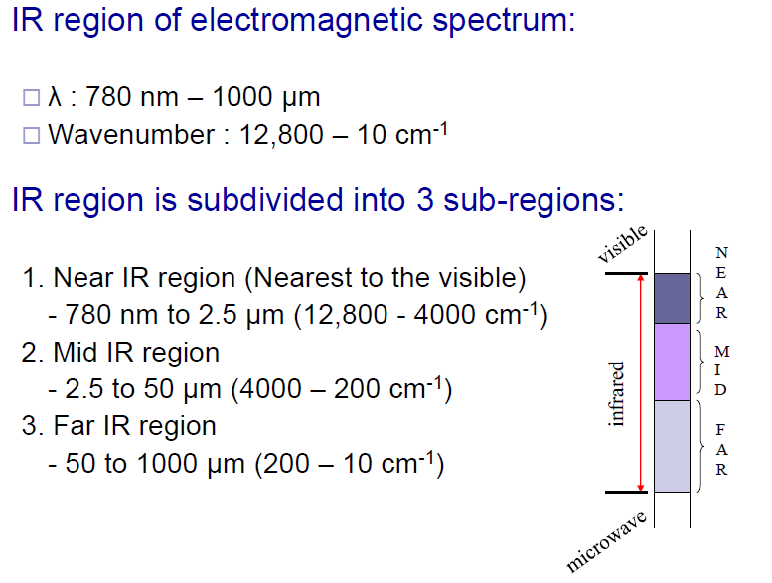

Slide 5
Molecular motion:
Three types of motion:
Translation, i.e., displacement of the whole molecule
Rotation
Vibration
All three types of motion have associated energies, but only rotational and vibrational motion have quantized energies
Under certain circumstances, the rotational and vibrational motion of a molecule can exchange (absorb or emit) energy with EMR this is the basis for rotational and vibrational
spectroscopies.

Slide 6
Stretching, bending, and internal rotation around single bonds are all examples of changes in the form of molecules.
IR absorption happens only when IR radiation interacts with a molecule that is vibrating or rotating and changing its dipole moment.
Infrared absorption happens only when the energy of the incoming IR photon is adequate to allow transition to the next permissible vibrational state.

Slide 7
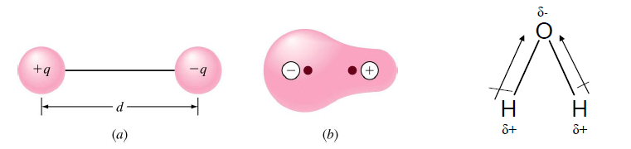
Dipolemoment

Slide 8
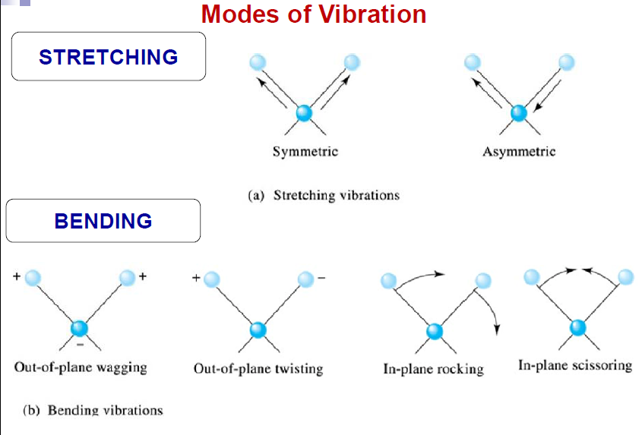

Slide 9
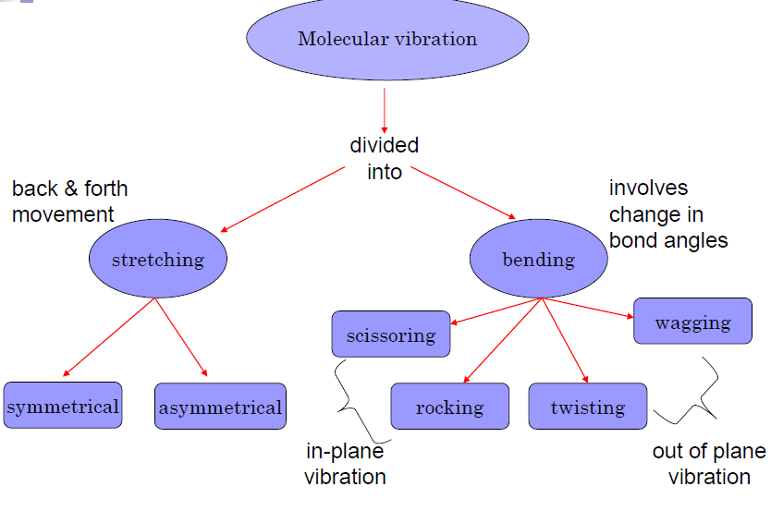

Slide 10
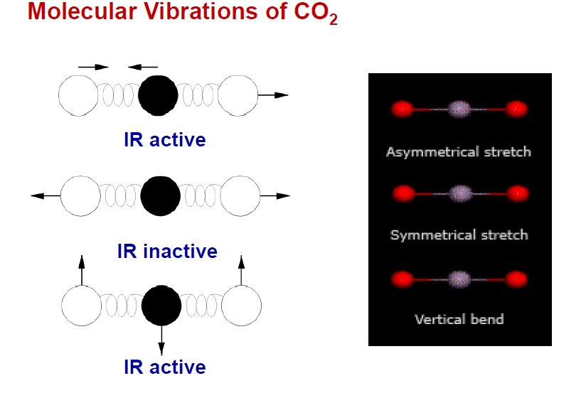

Slide 11
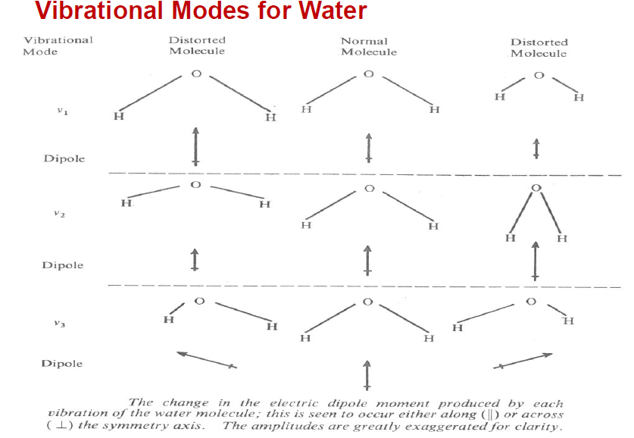

Slide 12
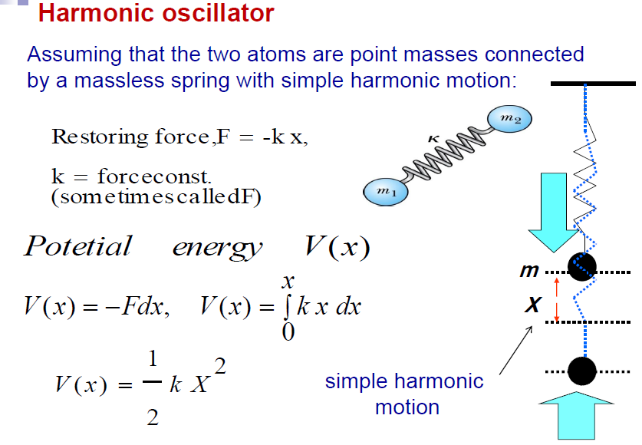

Slide 13
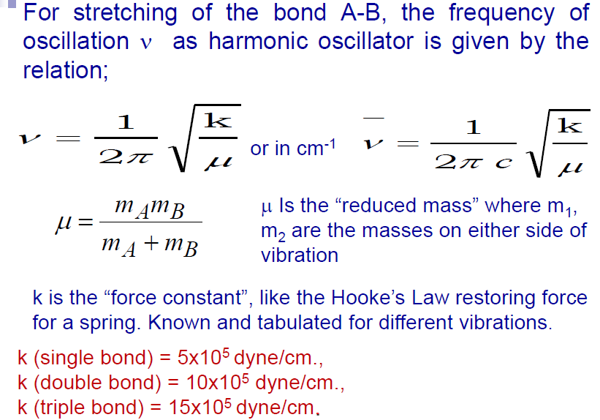

Slide 14
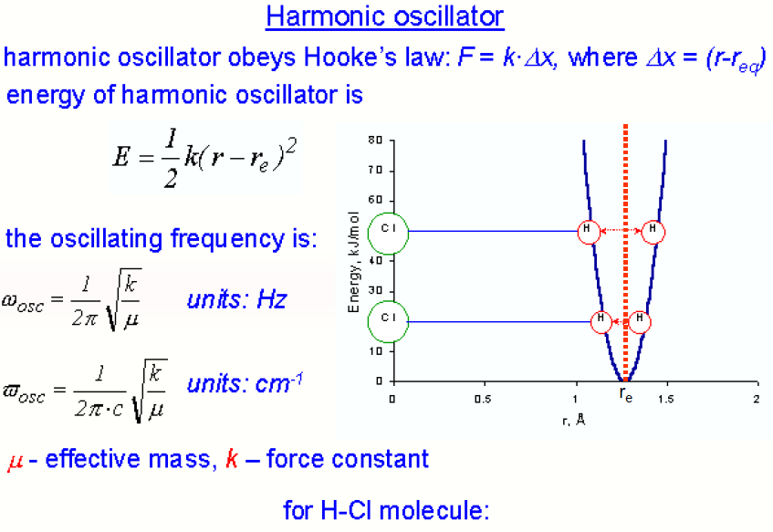

Slide 15

Vibrational energy

Slide 16
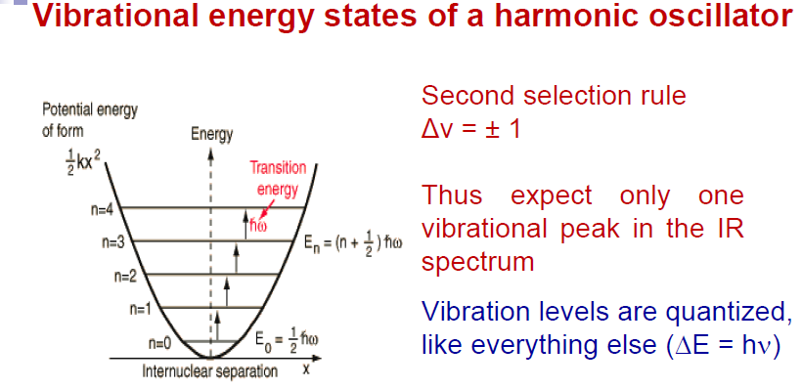

Slide 18
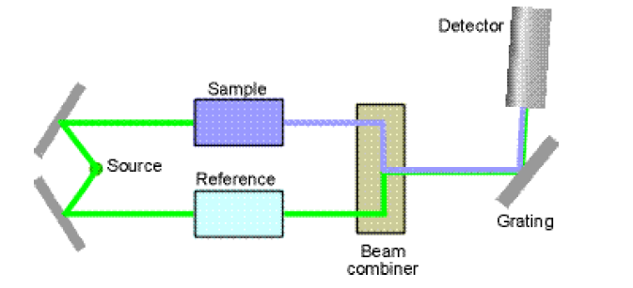
IR spectrophotometer

Slide 19
Born-Oppenheimer approximation
The time-scale for rotations is several orders of magnitude longer than the time-scale for vibrations, which in turn is several orders of magnitude longer than electronic transitions.
The energy levels are simply the sum of the energy contributions

Slide 20
References
Web sources

